Slide 1
CAMPUS ENERGY INTELLIGENCE
Phantom
Classrooms
Turning real campus usage into safer, explainable decisions.

Slide 2
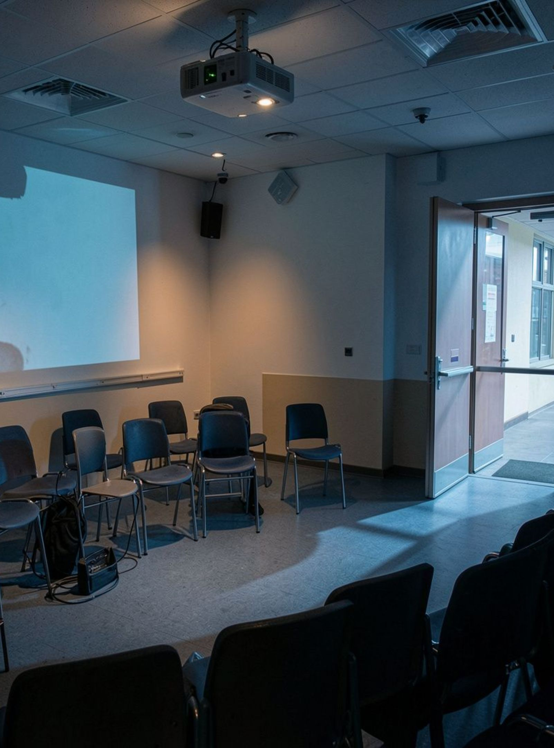
THE MISMATCH
Schedules describe intent.
Rooms reveal reality.
Timetables say when a room should be in use. The room often tells a different story.

Slide 3
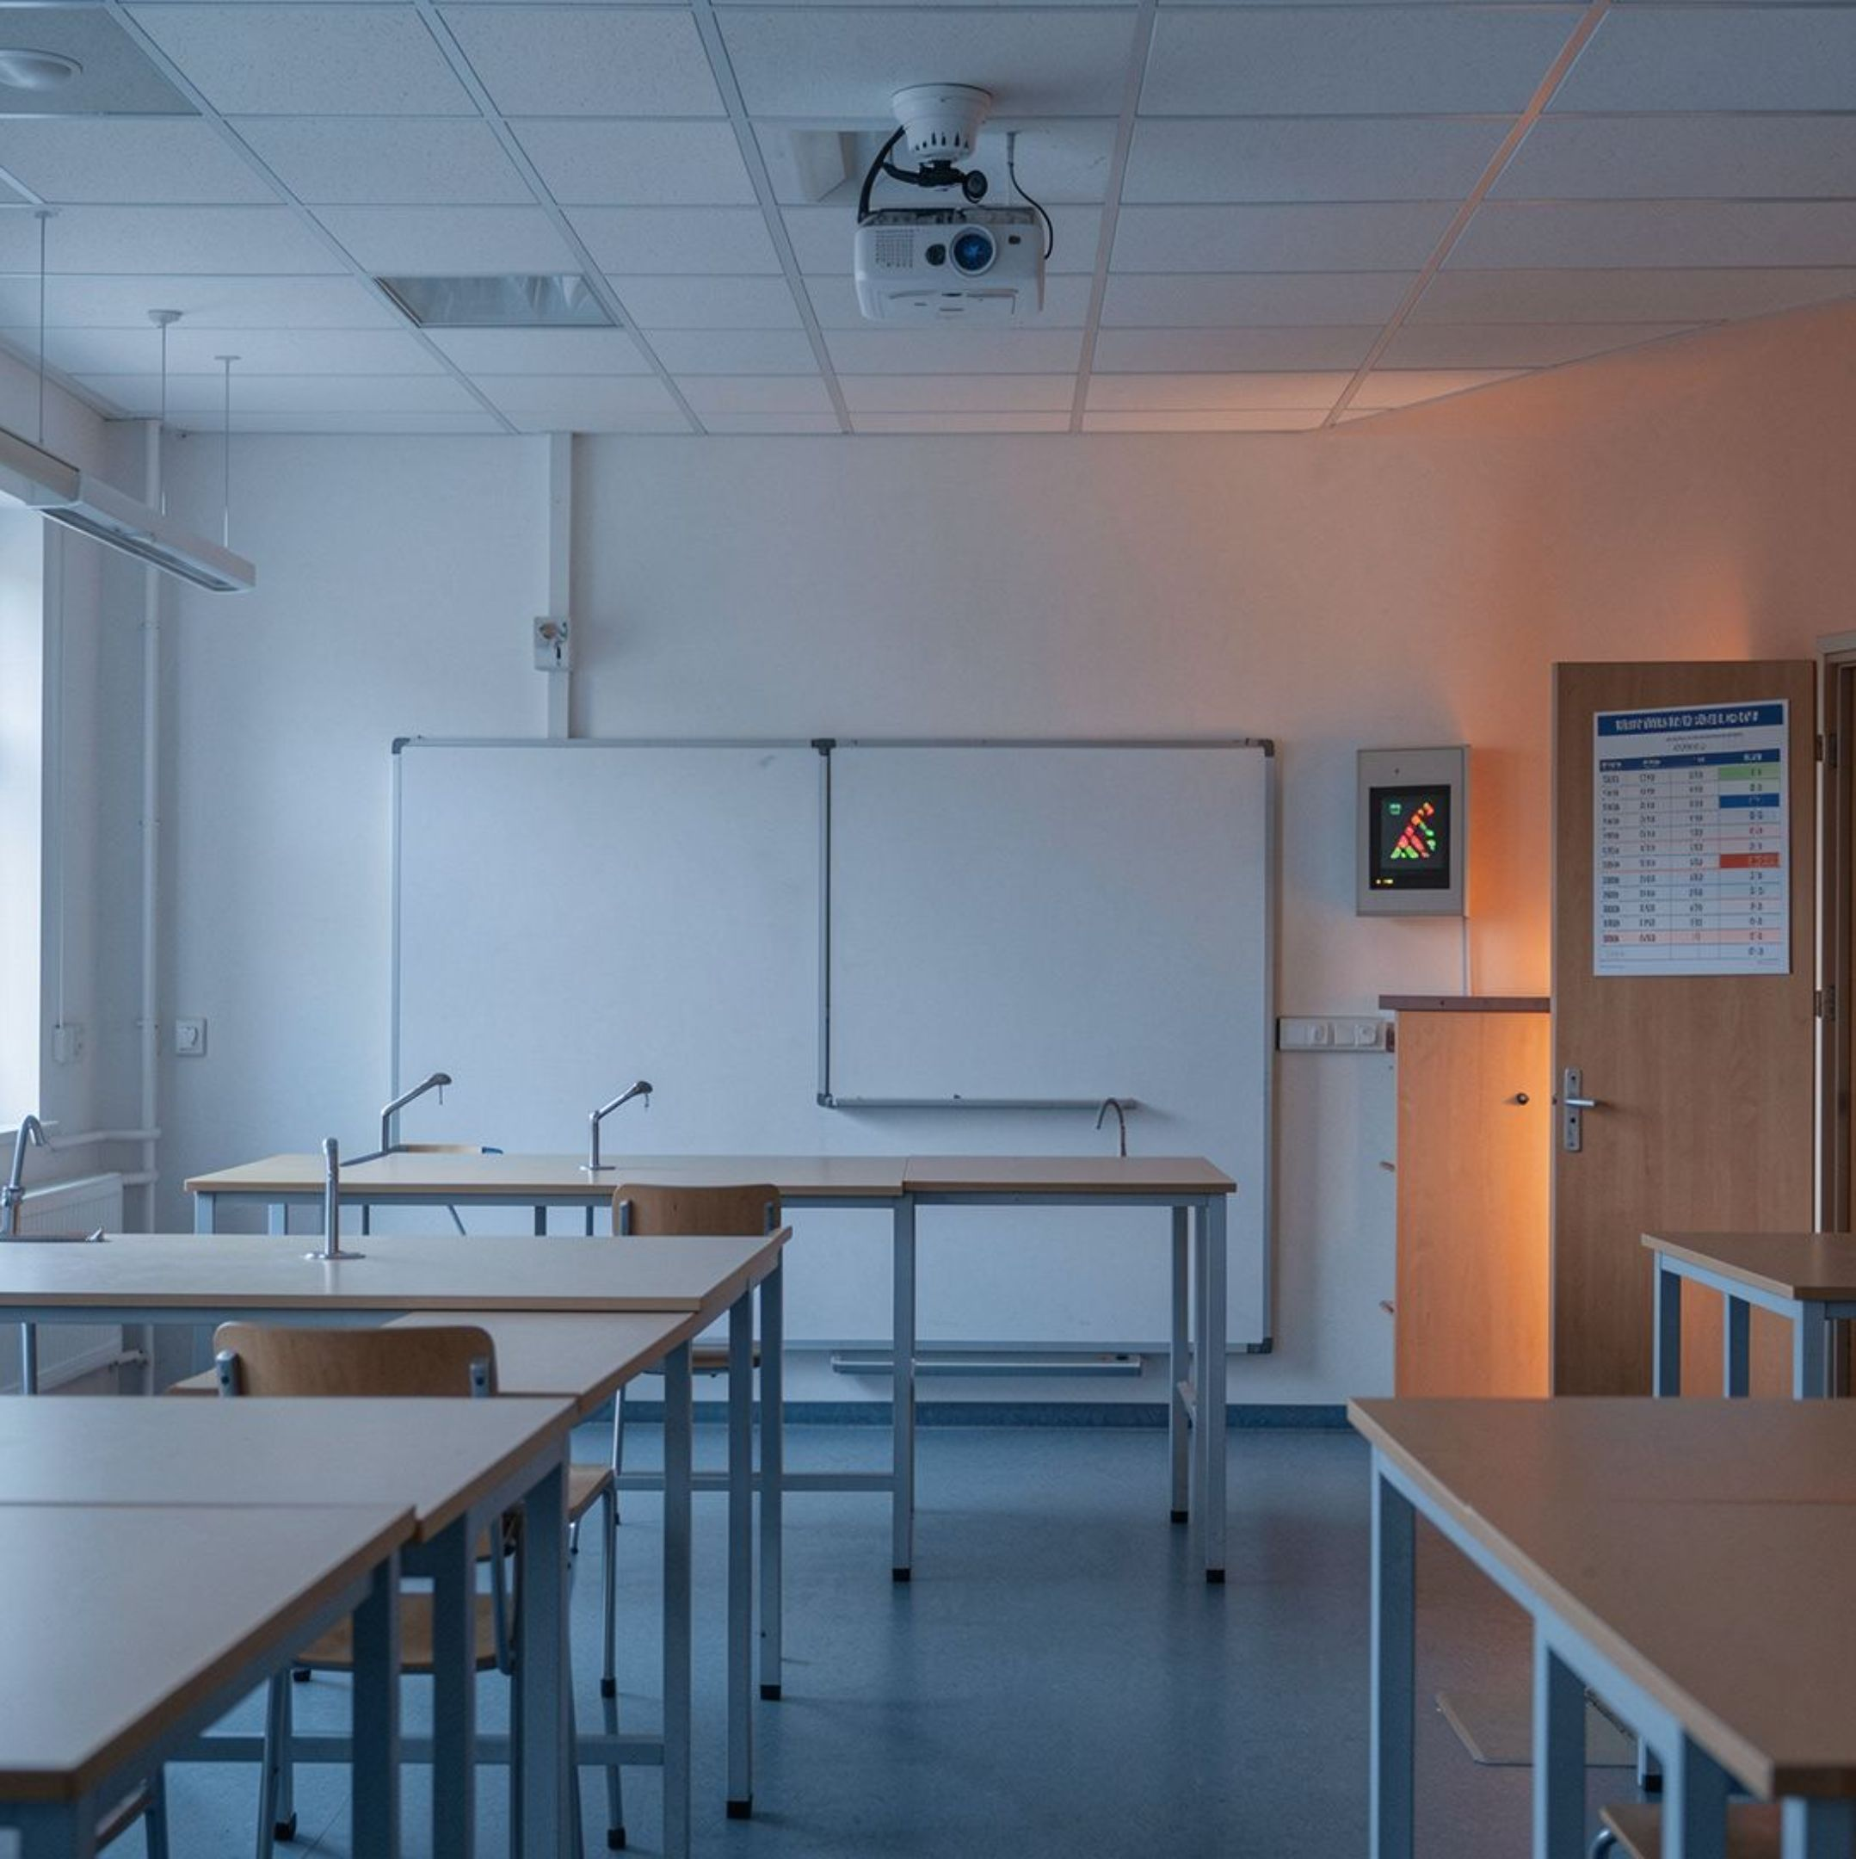
THE ROOM BECOMES A SIGNAL
One room,
many signals.
Camera, timetable, motion, equipment, and energy cross-check each other.

Slide 4
FROM INPUTS TO JUDGMENT
Confidence comes from fusion, not guesswork.
Agreement raises confidence. Conflict means verify.

Slide 5
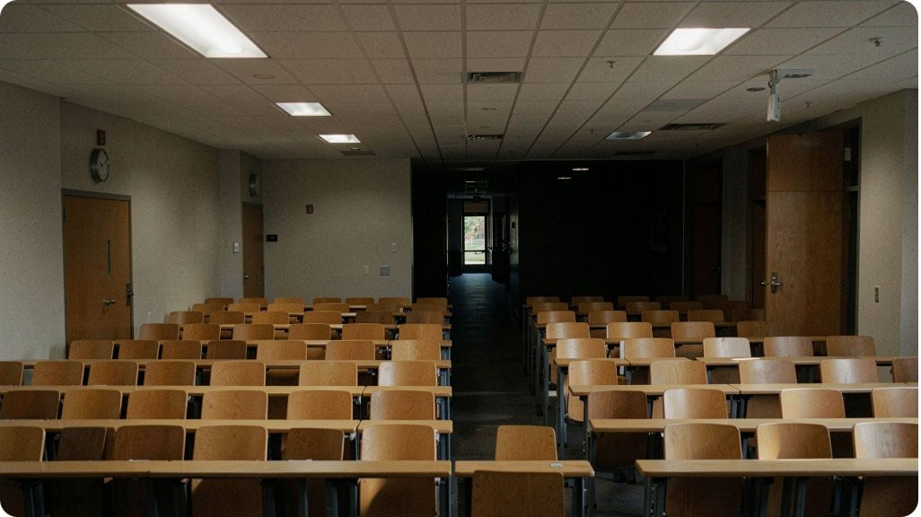
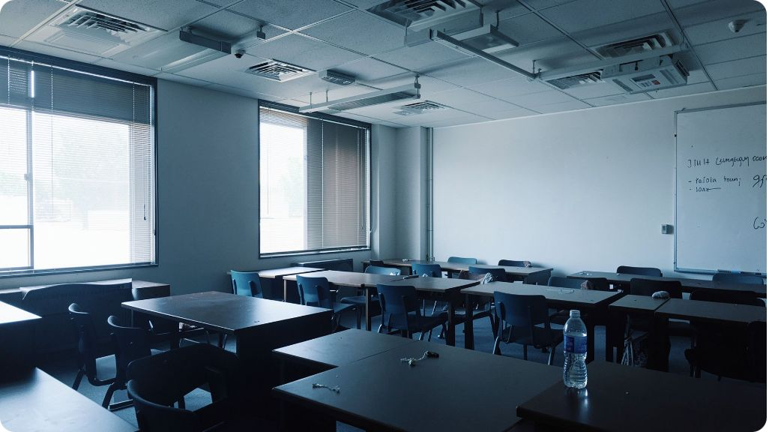

ACTIONABLE WASTE
Catch waste while it is still actionable.
Lights left on
Cooling an empty room
Projector still active
Watch for repeat offenders.

Slide 6
THE SAFETY GATE
Verify before the system acts.
When signals conflict, pause automation and ask for a second check.

Slide 7




RECOMMENDATION, NOT COMMAND
Recommend the safest next move.
Notify
Schedule a check
Reduce load
Switch off

Slide 8
BEFORE DEPLOYMENT
Make savings visible before deployment.
Test every change on paper first.

Slide 9
THE OPERATIONS VIEW
Find the rooms where waste repeats.
Room type | Recurring pattern | Next move
Classrooms | Lights after late sessions | Notify owner
Labs | Cooling after cancellations | Schedule a check
Seminar halls | Projector left on | Review policy

Slide 10

THE OPERATING PRINCIPLE
The Kindness Rule
Comfort first. Safety first. Human override, always.

